Slide 1
New York City School Safety Report analysis
Swetha Chamala
Bellevue University
DSC530 - Professor Metzger

Slide 2
How safe are public schools in NYC?
It is reported that the New York City Police Department (NYPD) has been tasked with the collection and maintenance of crime data for incidents that occur in New York City Public schools. The NYPD has provided this data to the New York City Department of Education (DOE) and DOE has compiled this data by schools and locations for the information of the general public.
Several news articles suggest that there is increase of crimes in the city's public schools. Especially in the school year 2017. My aim for this study is to identify trends in the total crimes with each school year. Whether there is an increase or decrease in the crime rate. If there is a trend, what sort of crimes occur the most - violent crimes, non-criminal cases, property crimes or other crimes. Find any anomalies if any.

Slide 3
Datasets
The datasets are available in the NYC.gov website
Dataset 1: 2010 - 2016 School safety report
https://data.cityofnewyork.us/Education/2010-2016-School-Safety-Report/qybk-bjjc
This data set has 34 columns and 6310 rows
Dataset 2: 2016 - 2017 School safety report
https://data.cityofnewyork.us/Education/2016-2017-School-Safety-Report/rear-wh5i
This data set has 33 columns and 2046 rows

Slide 4
Variables
The variables I chose for analysis are -
Major N - Number of major crimes
Oth N – Number of ‘other’ crimes
NoCrim N – Number of non-criminal crimes
Prop N – Number of property related crimes
Vio N – Number of violent crimes

Slide 5
Histograms of Dataset 1
The 5 variables - Major_N, NoCrim_N, Oth_N, Prop_N, Vio_N have similar distributions with smaller values. Thereby same trend is observed in their corresponding 'Avg' distributions.

Slide 6
Histograms of Dataset 2
Similar to dataset 1, the 2016-2017 dataset 2 also follows the same trends.
The 5 variables - Major_N, NoCrim_N, Oth_N, Prop_N, Vio_N have similar distributions. Thereby same trend is observed in their corresponding 'Avg' distributions.

Slide 7
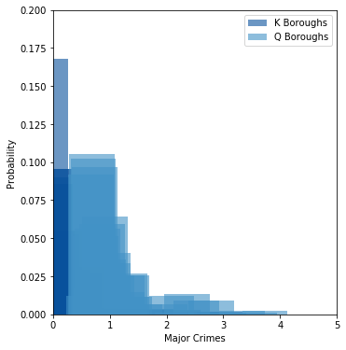
PMFs
Plotting PMFs of ‘AvgOfMajor_N’ grouped by K (Brooklyn) and Q (Queens) boroughs as an example of PMF plots shown in page 29 of Thinkstats book

Slide 8
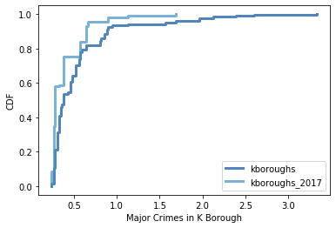
CDFs
Plotting CDFs of ‘Major_N’ column of dataset 1 (2010-2016) and dataset 2 (2016-2017)
The plot shows that the reported major crimes are higher for 2010-16 compared to 2016-17

Slide 9
Hypothesis
Several news articles suggest that there is increase of crimes in the city's public schools.
Especially in the school year 2017.
So, I will be testing the hypothesis that the school year 2016-17 has higher crime rates reported than previous years.
The null hypothesis would state the opposite.
References:
https://www.nydailynews.com/new-york/education/crime-nyc-public-schools-nypd-data-shows-article-1.3851995
https://www.nyclu.org/en/press-releases/nypd-releases-complete-school-safety-data-first-time
https://www.the74million.org/article/exclusive-how-safe-are-nycs-schools-new-interactive-map-compares-what-teachers-students-are-reporting/
https://www.wnyc.org/story/school-safety-incidents-vary-depending-who-counts/

Slide 10
Testing hypothesis
I tested hypothesis by calculating means and differences. Means of ‘all types of crimes’ of datasets grouped by school year
Dataset 1 (2010-2016) Dataset 2 (2016-2017)
2013-14 | 0.0 | 126.0 | 8.102979
2014-15 | 0.0 | 128.0 | 7.950169
2015-16 | 0.0 | 130.0 | 7.711149
2016 - 17 | 0.0 | 114.0 | 7.485501
Ttest_indResult(statistic=1.0085891763517827, pvalue=0.31322309609765847)
Total crime rates of the year 2017 are not higher compared to previous years.
P-value > 0.05 suggests null-hypothesis is true. Which proves my hypothesis wrong. Implying that school crimes are not on the rise compared to previous years.

